Slide 1
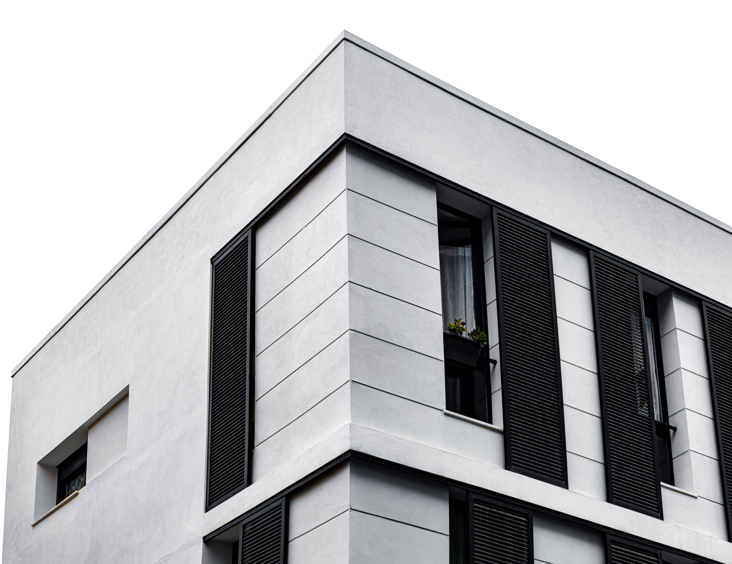

Note:
This is just a summary of the projects.
Not all the features are presented here.
By: - Hussam Chihadeh
- Mohammad Jamil Chahine
Instructor: Dr. Azzam Mourad

Slide 2
Problem Statement
no integrated platform that combines property listings, furniture options, and designer collaboration
Inefficient property search
Inconvenient furniture selection
Communication and coordination issue between customers and designers

Slide 3

Why are we Unique?
Create a user-friendly platform, "Dream Home," that combines real estate listings, furniture options, and designer collaboration for a seamless experience.
Facilitate communication between customers and designers through an integrated chat system.
Improve property search with advanced filters and an intuitive interface.
Enhance user experience with a mapping feature.
Simplify furniture selection with a comprehensive database and recommendations.

Slide 4
Technologies Used
HTML
CSS
Javascript
Bootstrap
JQuery
Laravel
MySQL

Slide 5
Key Features
Property Search and Filtering
Property Listing and Details
Property on Map
Furniture Search and Filtering
Furniture Recommendation
Cart Management and Checkout
Integrated Chat for Designer Communication
Property Selling
User Profile Management
Administrative Pages

Slide 6
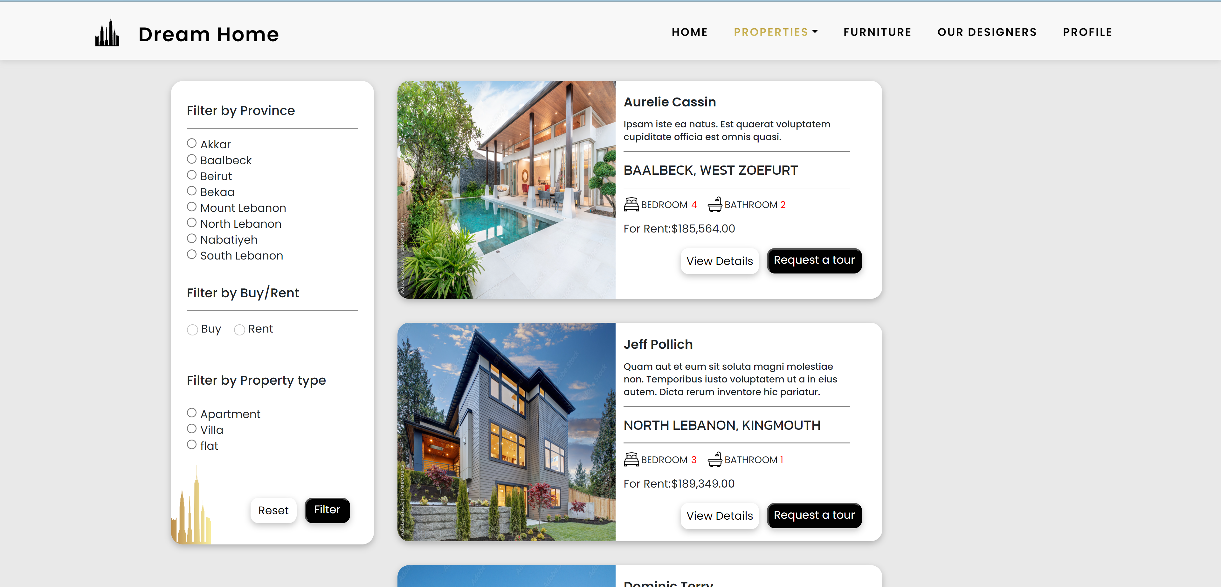
Want to Buy/Rent a House?

Slide 7
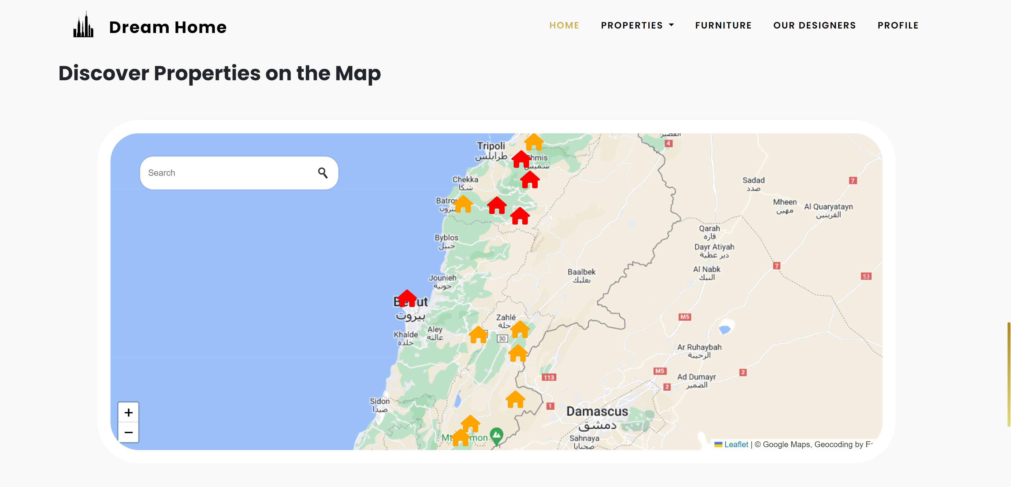
View also Properties on the Map

Slide 8
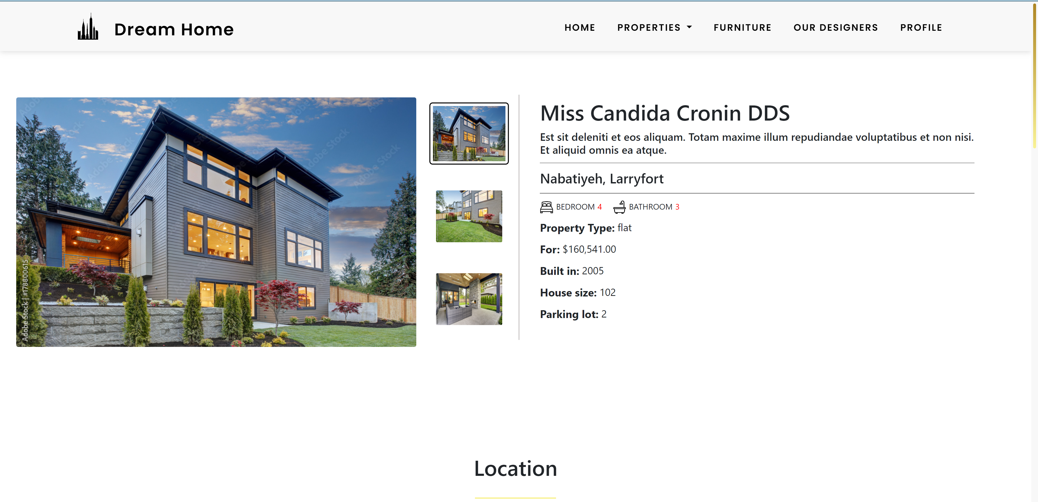
You can View its details

Slide 9
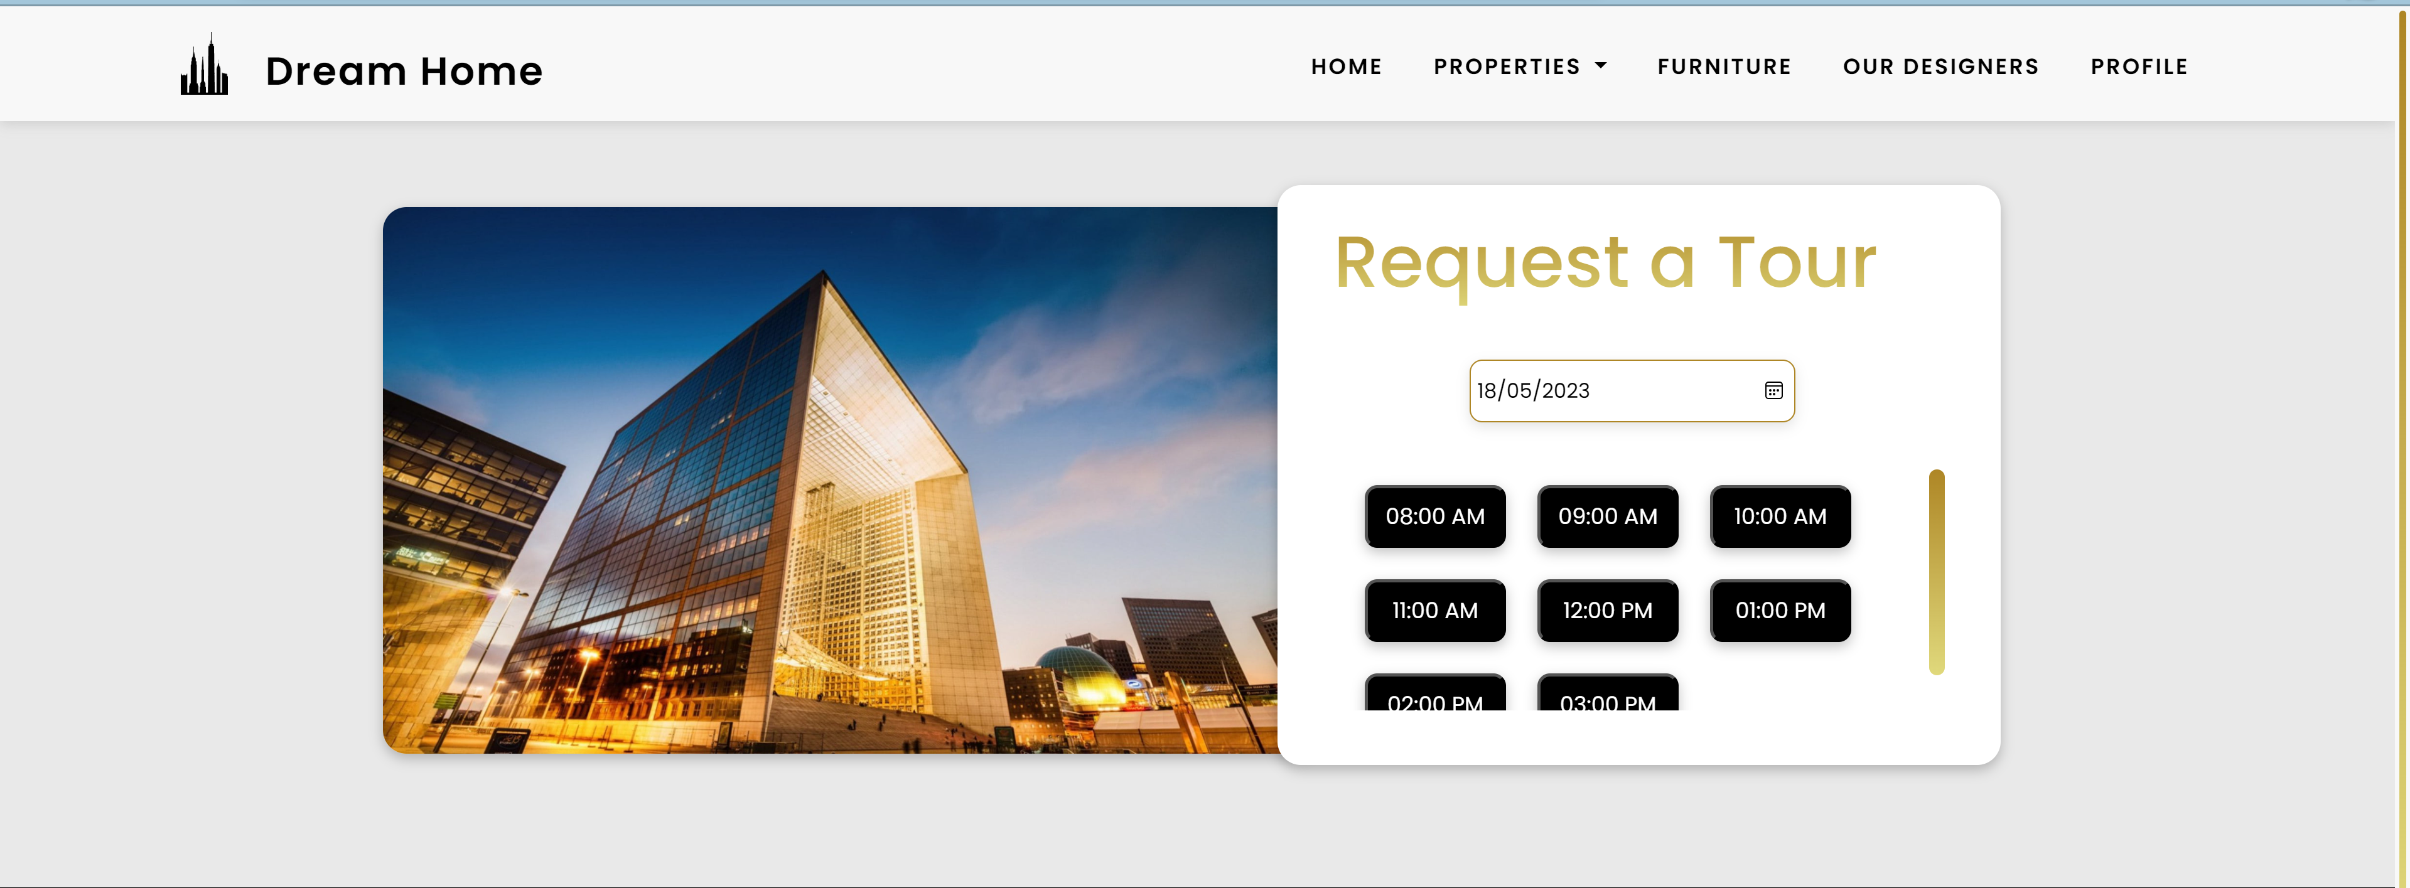
Simply choose a preferred date and time, and your tour will be reserved.

Slide 10
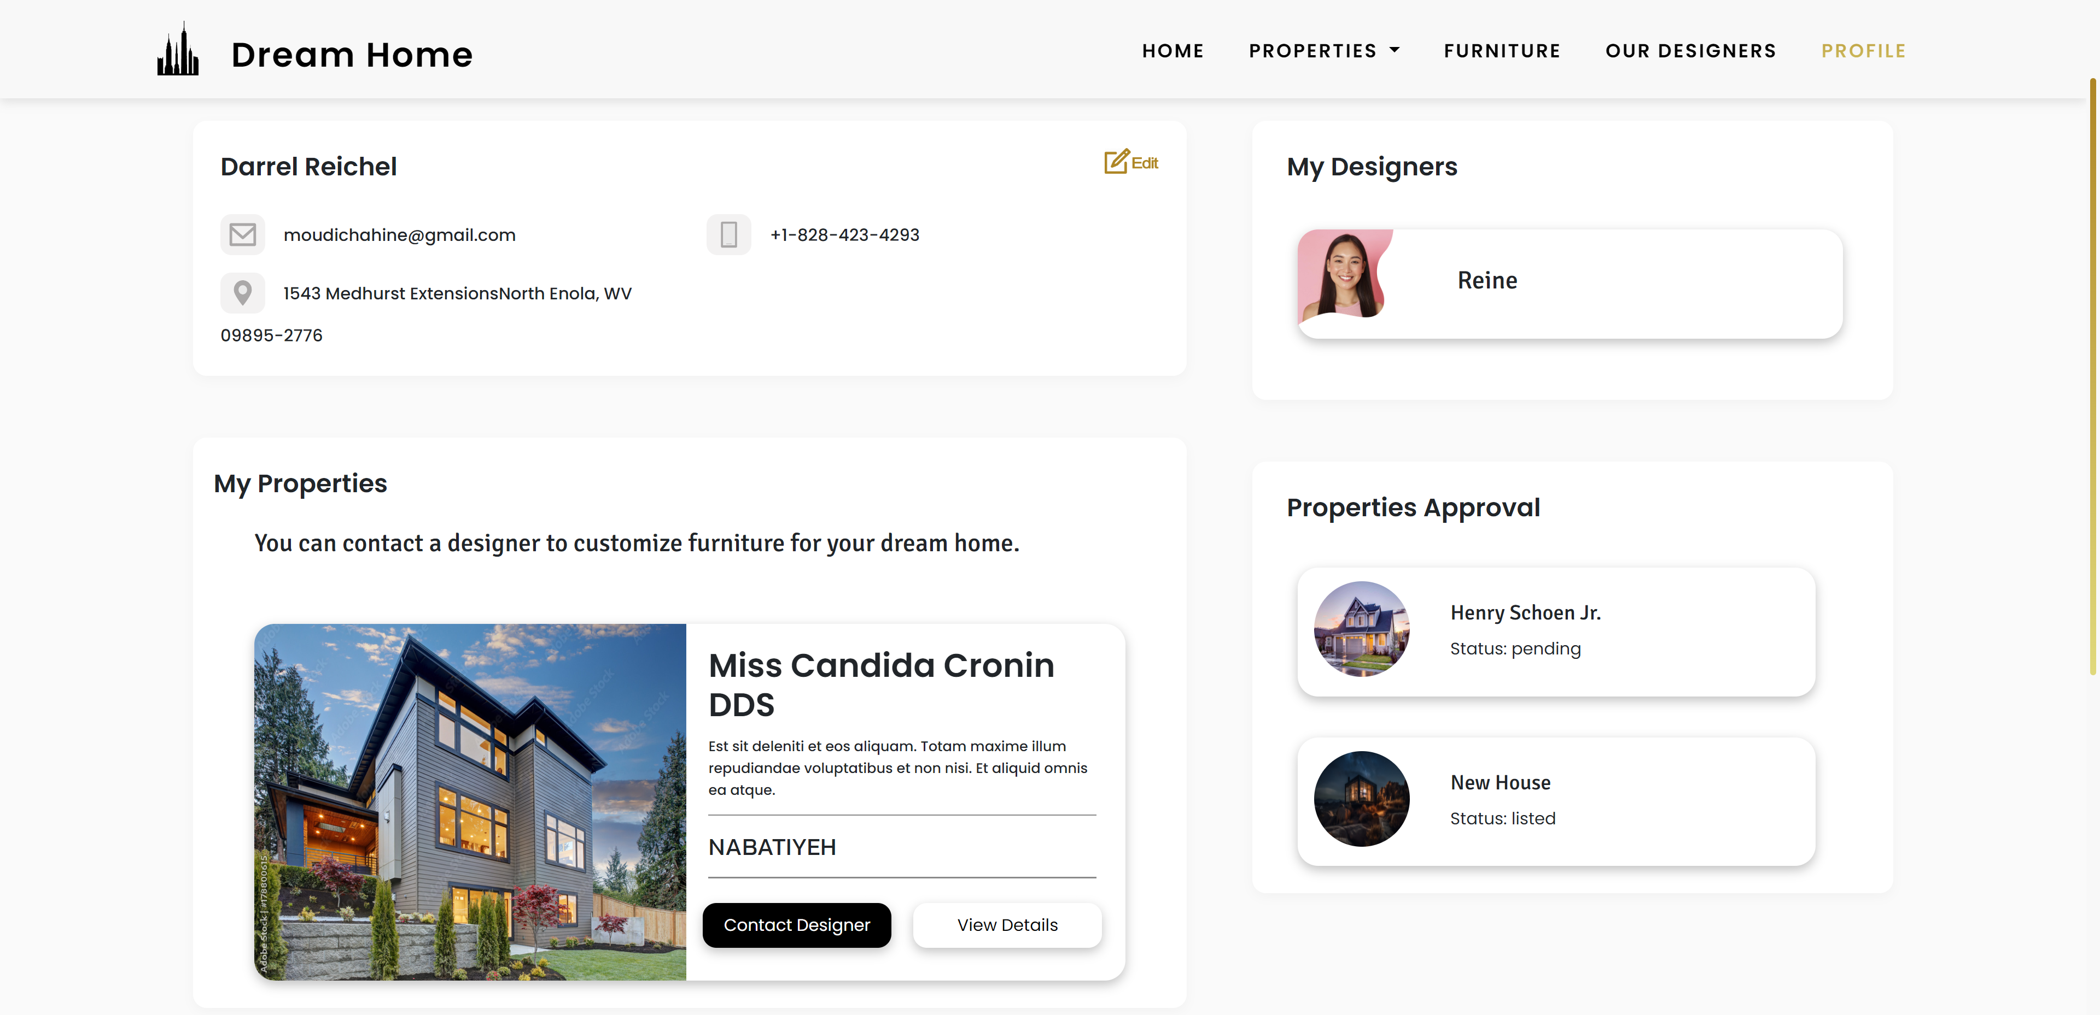
Once you have finalized purchasing your house, you can easily connect with a professional designer to transform it into your dream home.

Slide 11
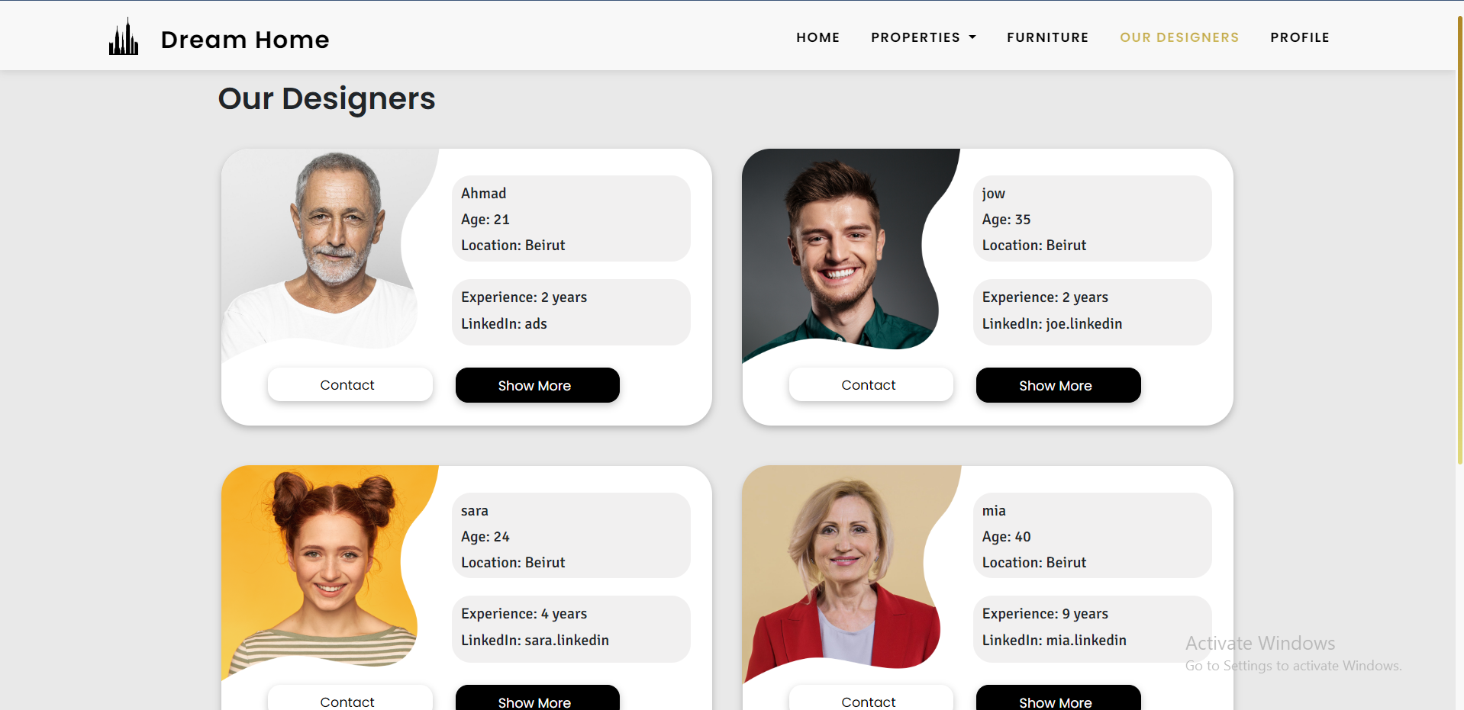
Choose a Designer to contact

Slide 12
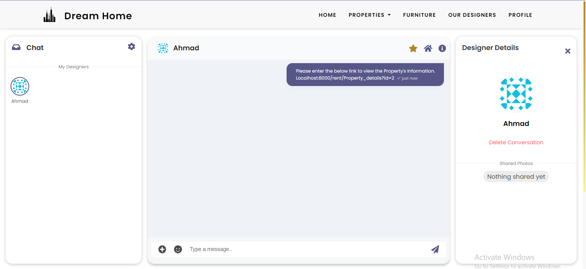
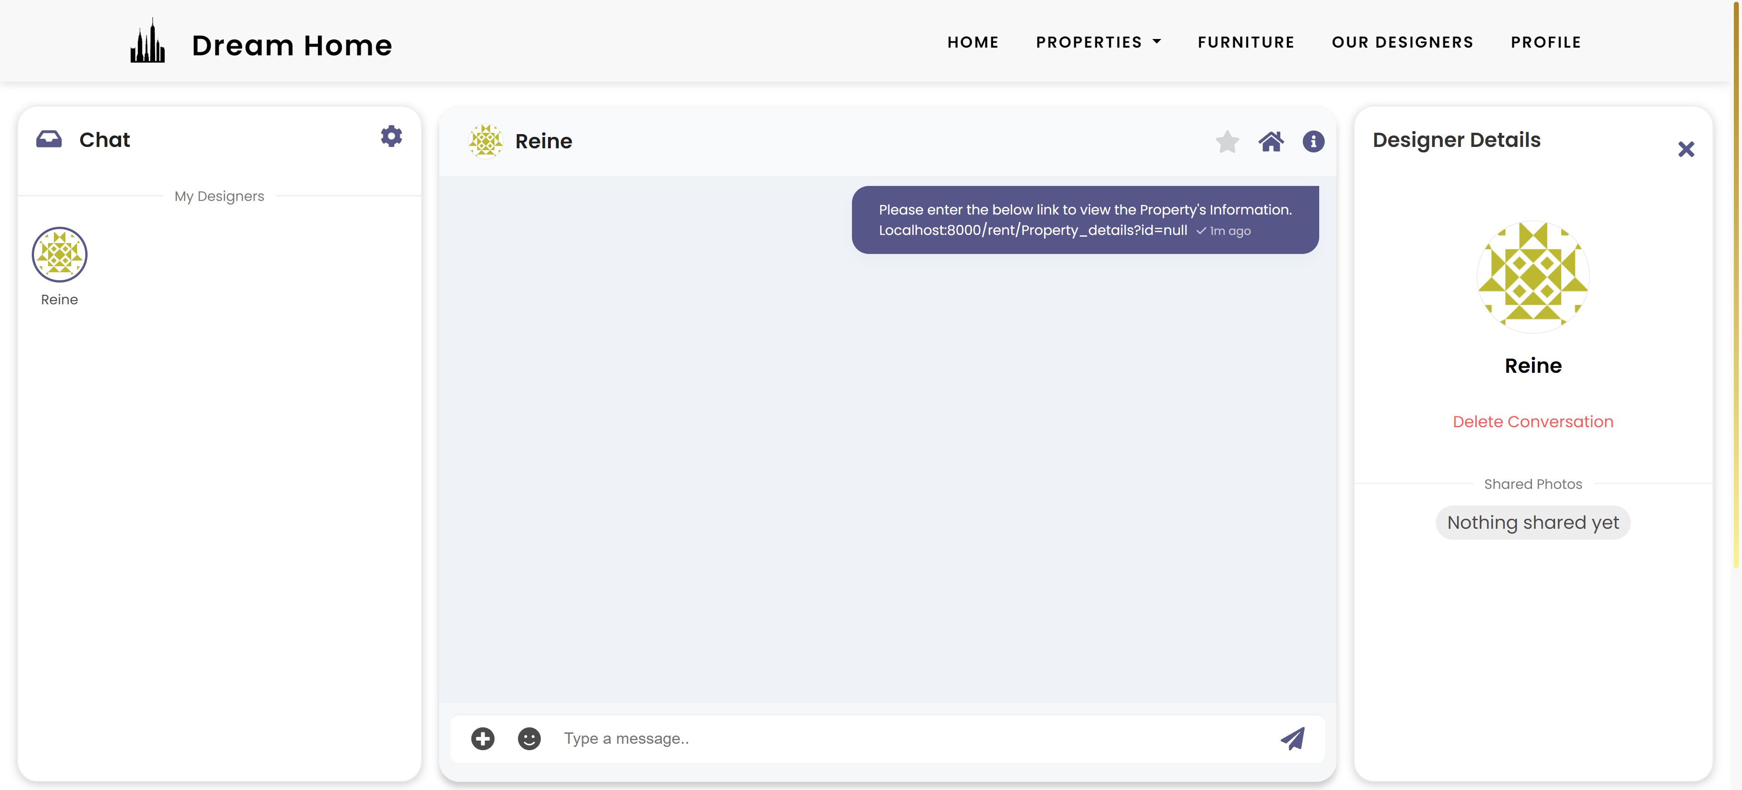
Start Chatting

Slide 13
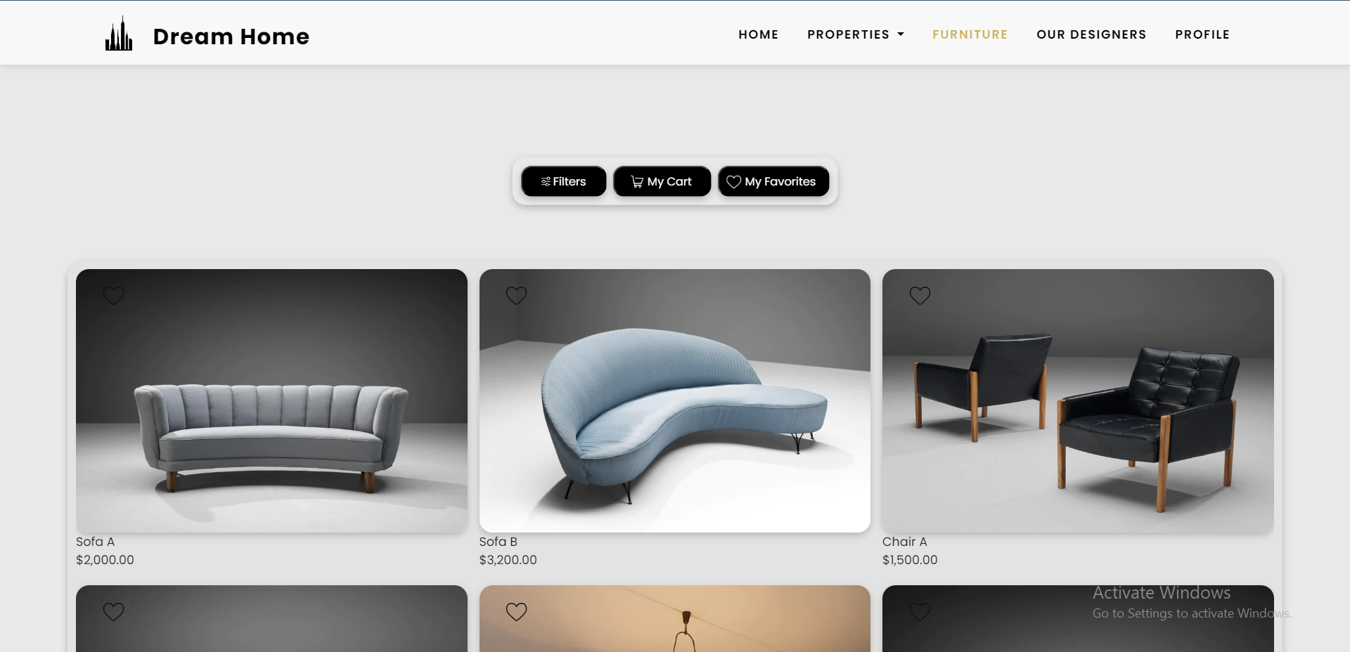
Alternatively, you have the option to furnish your house according to your own preferences and style.

Slide 14
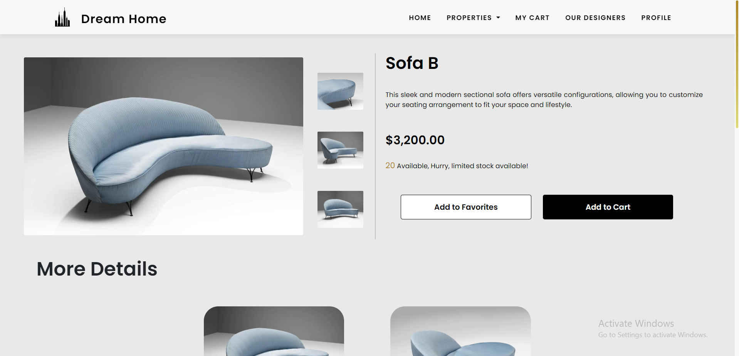
View Furniture Details

Slide 15
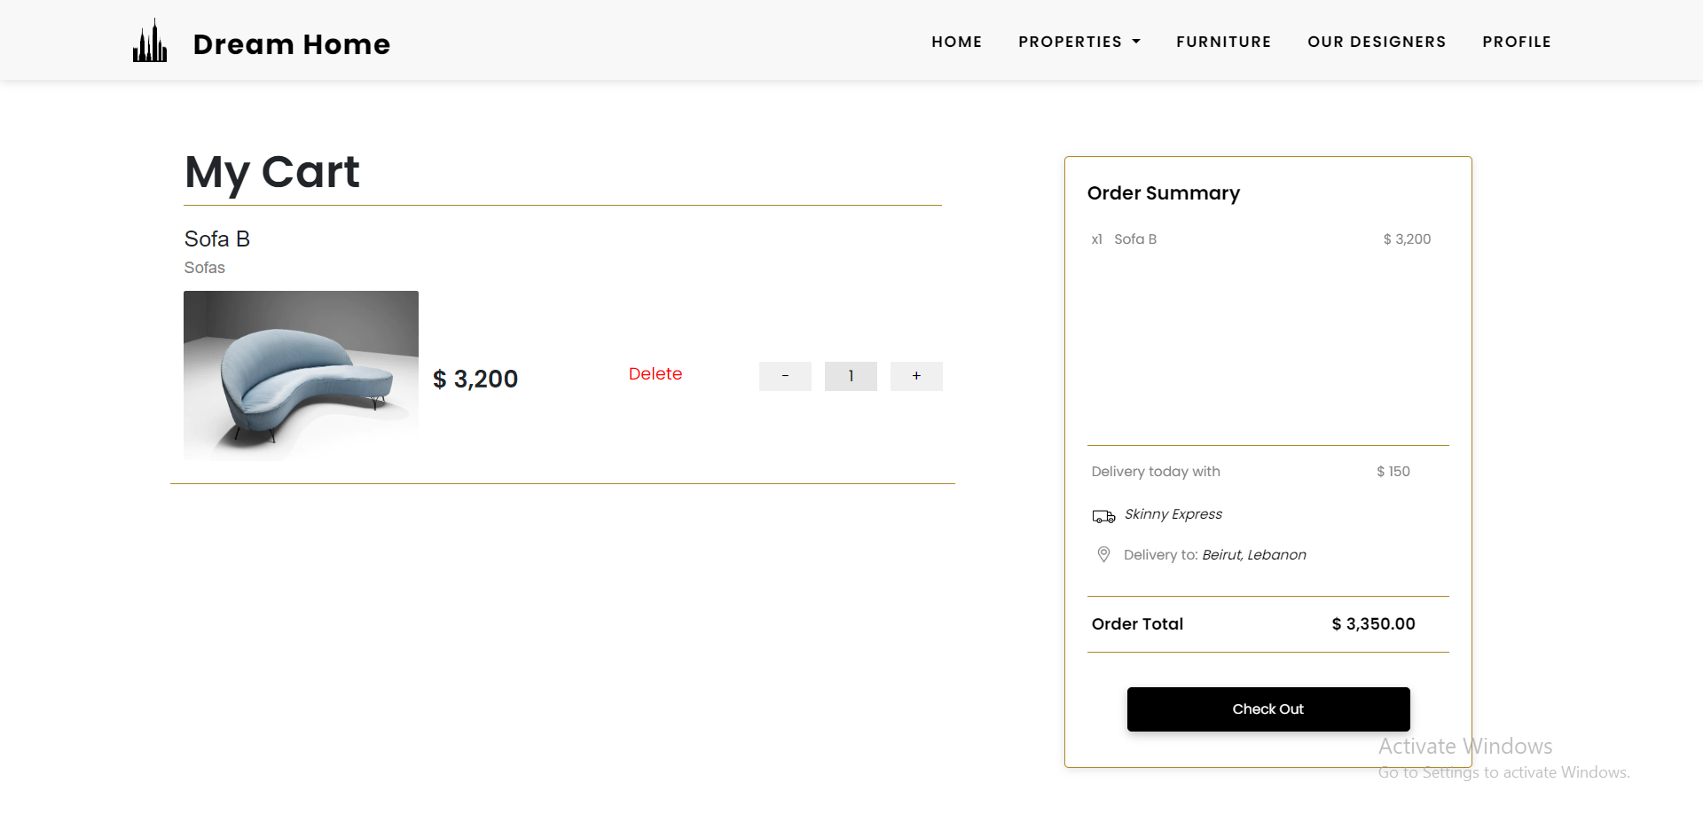
My Cart

Slide 16
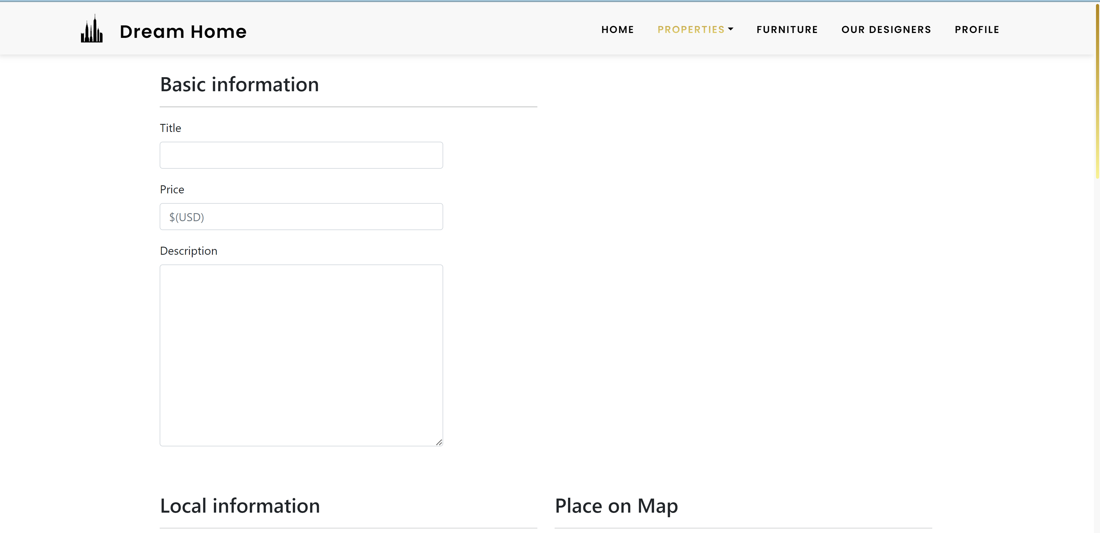
You can sell your property

Slide 17
Track the Requests

